Slide 1
Whole exome data and variant calling
Aled Jones

Slide 2
Overview
Recap - what we have
Variant calling
preprocessing
variant calling
variant filtering
variant annotation

Slide 3
Revision of terms

Slide 4
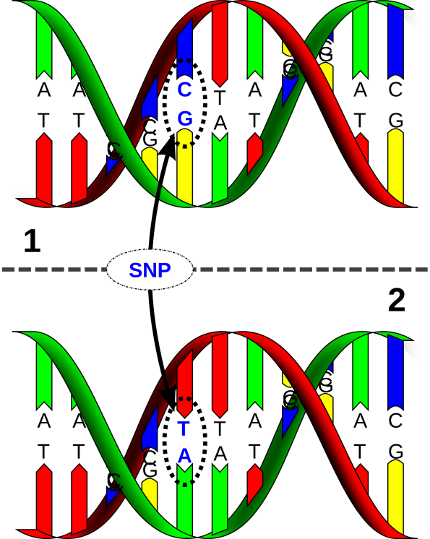
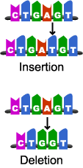
Revision of terms
SNV
Insertion
Deletion

Slide 5
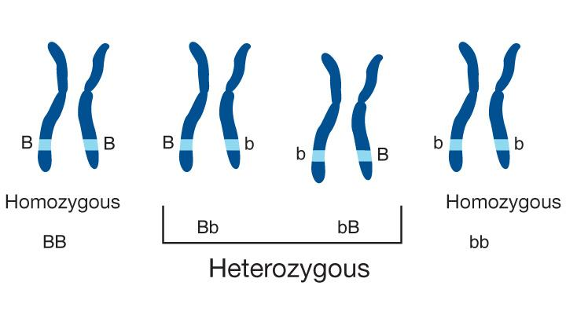
Revision of terms
Homozygous/Heterozygous
Ref/Alt

Slide 6
Coverage
Coverage/depth/read depth
Refers to two measures and unfortunately “coverage” often used for both
Read depth = Number of times a base has been sequenced
Coverage = Amount of region of interest covered above a set read depth
⬆Read depth: ⬆ Coverage:
rescues sequencing errors
gives more confidence in call
Trade off between cost (# samples per experiment) and coverage
A clinical report is accompanied with coverage report stating % of each exon and gene @ X1,X5,X10,X20,X30, X50, X100,X150,X200.
Important to identify regions which were not covered sufficiently

Slide 7
Coverage

Slide 8
What do we have

Slide 9
BAM file contains aligned reads
Raw sequencing image → fastq
fastq → mapped to reference (SAM)
SAM → BAM
BAM sorted and indexed

Slide 10
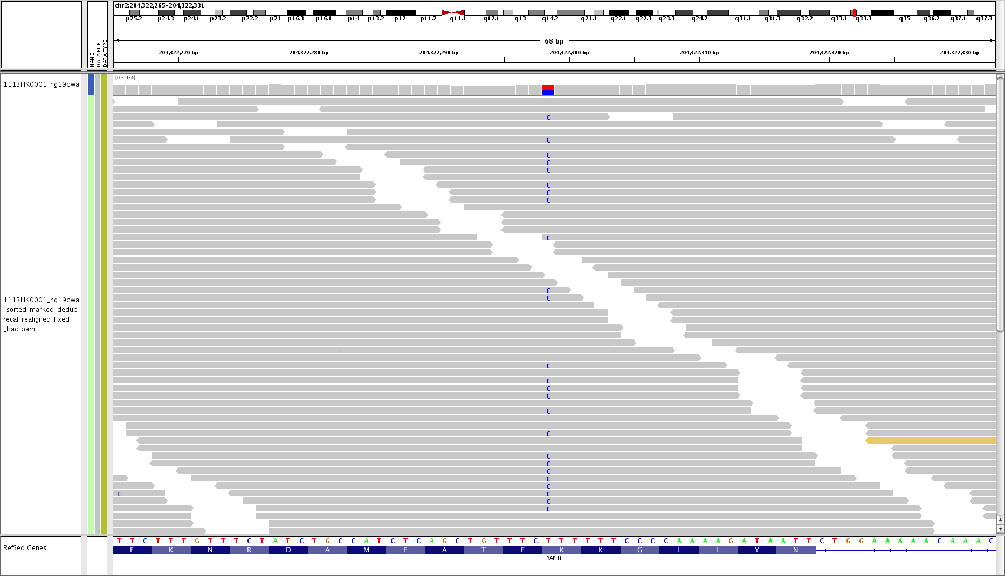
In principle it is very easy…

Slide 11
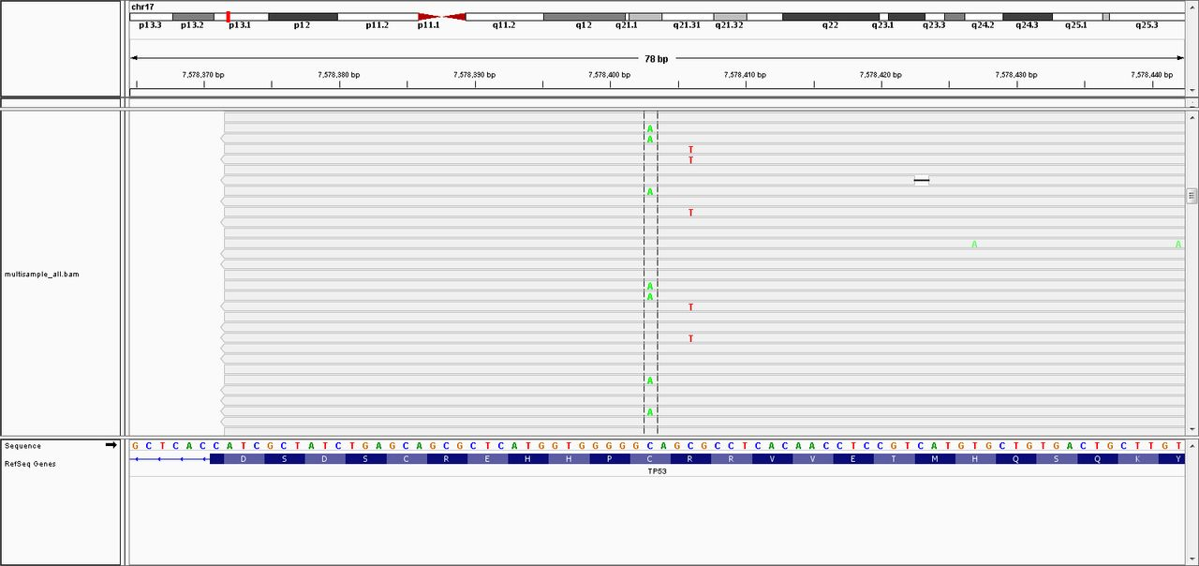
But the reality is somewhat different…

Slide 12
Workflow
Sequencing
Read Mapping
Pre-processing
Variant Calling
This talk
Variant Filtering
Variant Annotation
Filtering/ Prioritisation
Validation

Slide 13
Preprocessing

Slide 14
Workflow
Sequencing
Read Mapping
Pre-processing
Variant Calling
This talk
Variant Filtering
Variant Annotation
Filtering/ Prioritisation
Validation

Slide 15
Useful tools
SAMtools
Utilities for manipulating SAM/BAM files
GATK
Genome analysis toolkit – variety of tools for variant discovery, genotyping and quality
Picard
Utilities for manipulating SAM/BAM files

Slide 16
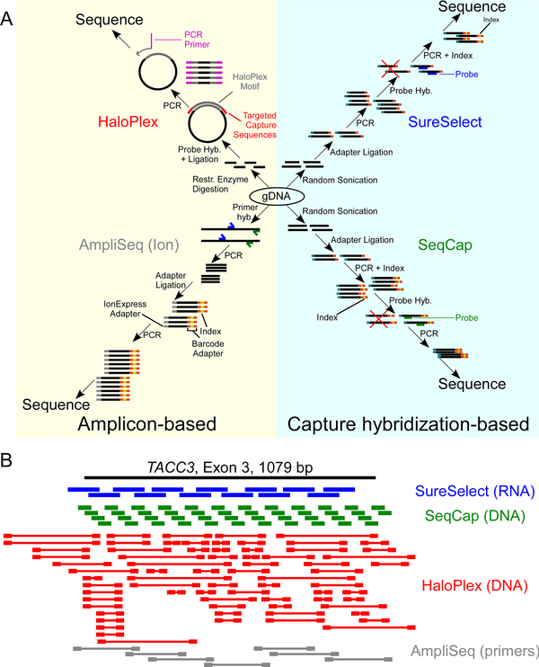
Reminder: NGS Capture methods
Amplicon based capture uses PCR to amplify regions of the genome for sequencing.
Targeted capture based randomly fragments the DNA, amplifies it and then uses probes to select amplified DNA
Notes:
To select for the regions of interest there are a few different approaches
Amplicon based selects the regions using primers and then amplifies
Capture based amplifies and then captures.

Slide 17
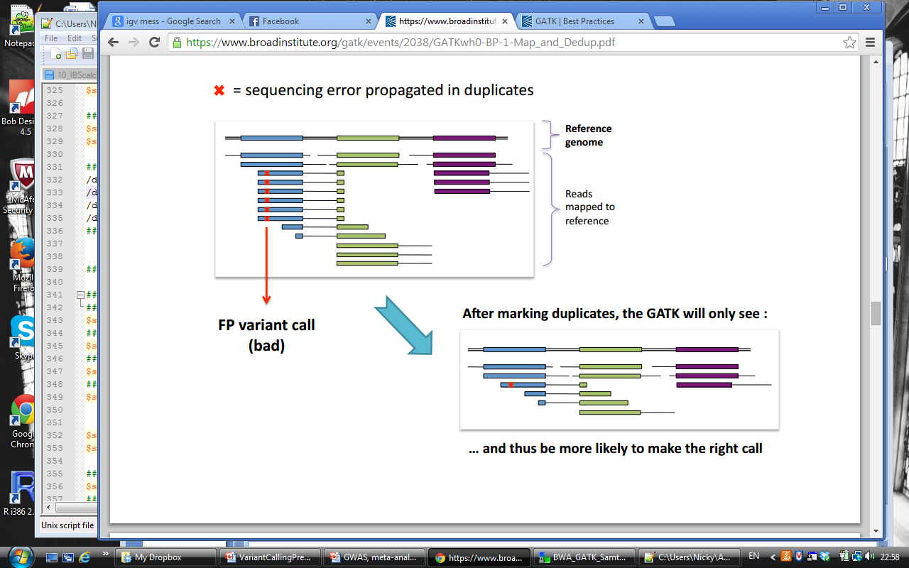
Pre-processing – mark duplicates
NOT FOR AMPLICON BASED CAPTURE!
Generated as a consequence of PCR
https://www.broadinstitute.org/gatk/events/2038/GATKwh0-BP-1-Map_and_Dedup.pdf

Slide 18
Pre-processing – mark duplicates
https://www.broadinstitute.org/gatk/events/2038/GATKwh0-BP-1-Map_and_Dedup.pdf

Slide 19
Pre-processing – score recalibration
Base quality scores are assigned based on noise in base calling images - systematic bias
Variant callers use quality scores to assign confidence to a call – need to be accurate
Corrected using machine learning approach to model errors and adjust scores
GATK

Slide 20
Pre-processing – score recalibration
Basically updates the predicted error rates with based on the errors seen in the reads
SAMtools mpileup recalibrates the BAQ based on:
base quality
sequence context
position in read
GATK haplotype caller also takes into account:
realignment around indels
Notes:
Base quality = based on what has been seen
Sequence context = surrounding bases
position in read = end of read?

Slide 21
Phred quality scores
Characterise the quality of DNA sequences
q = -10log₁₀(p)
p = error probability for the base
Phred quality score | Probability | Base call accuracy
10 | 1 in 10 | 90%
20 | 1 in 100 | 99%
30 | 1 in 1,000 | 99.9%
40 | 1 in 10,000 | 99.99%
50 | 1 in 100,000 | 99.999%

Slide 22
Pre-processing - others
Add or replace read groups (which read belongs to which sample) – Picard
Sort reads by start position - Picard
Local realignment around indels - mismatched reads at indel boundaries might look like evidence for SNPs [originally each read is individually mapped to the reference to cut computational cost] – GATK
Notes:
BWA does not retain the readgroup information so cannot determine genotype. Done using picard tools
Read group is based on one of the indexes - if not been demultiplexed can move the read groups around at the BAM stage.

Slide 23
Variant calling

Slide 24
Workflow
Sequencing
Read Mapping
Pre-processing
Variant Calling
This talk
Variant Filtering
Variant Annotation
Filtering/ Prioritisation
Validation

Slide 25
Too many tools!
GATK unified genotyper
GATK haplotype caller
SAMtools
SOAPsnp
SOAPindel
Pindel
Dindel
Scalpel
Platypus
varScan
varDict
Glftools
Atlas2
Mpileup
MuTect
BayesCall
BreakDancer
And many, many more...

Slide 26
Reasons for a mismatch
True SNP
OR
Error in library prep
Base calling error – sequencing
Affected by ⬇coverage
Mapping error (misalignment)
Hard in repetitive regions
Try local realignment
Error in reference genome

Slide 27
General principles
Identify sites that differ from the reference
Estimate likelihood this is a variant or sequencing error taking into account:
Base quality score
Proximity to indel
Repetitive regions (e.g. Homopolymers)
Mapping qualities of supporting reads
Read length
Position in read
Paired reads
Coverage
Strand bias
Local de novo realignment in ‘active’ regions
Output quality score for variant call

Slide 28
General principles
Early methods
Simply count numbers of reference and alternate reads – simple cut off to identify variants
Bayesian methods
Take into account counts as well as base and mapping qualities
Posterior probability of each possible genotype is output – used to calculate quality score

Slide 29
What comes out

Slide 30
mpileup
Samtools mpileup variant caller produces an mpileup file
samtools mpileup -uf ref.fa aln1.bam
bcftools converts this to a vcf file (it can also convert to a binary vcf (bcf))
bcftools call -cNvf GQ -> variants.vcf
bcftools:
converts between formats
enables filtering

Slide 31
VCF file format
Created as part of 1000 genomes project
http://www.1000genomes.org/wiki/Analysis/vcf4.0

Slide 32
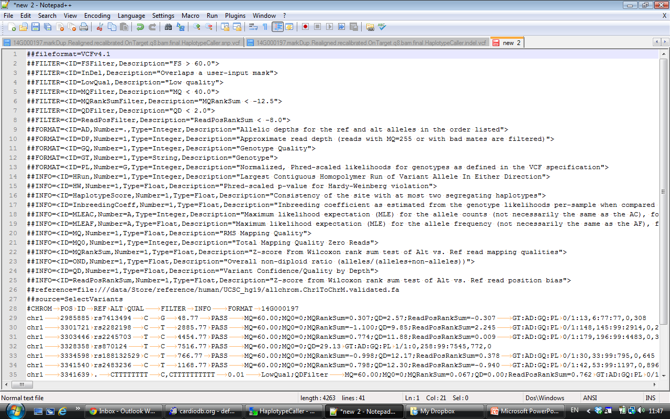
VCF file format

Slide 33
VCF file format
Header lines start with ##
This details all the fields within each row

Slide 34
VCF file format
Variant section starts with the column headers starting with #
Then one row per variant

Slide 35
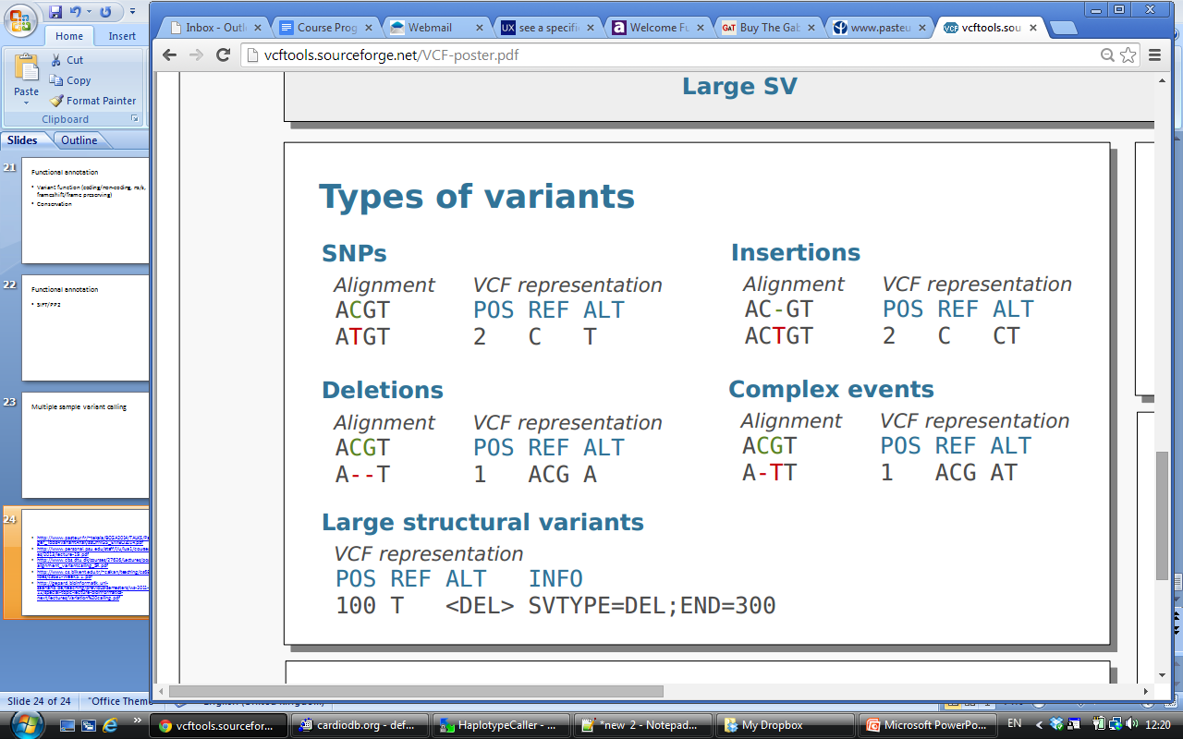
Types of variants
http://vcftools.sourceforge.net/VCF-poster.pdf

Slide 36
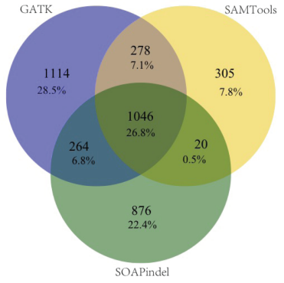
Indels are a different problem
Lots of false pos SNPs near true indels
Mismatches penalised less than gaps
Local de novo realignment
Little concordance between popular callers
Lag behind SNV callers
O’Rawe, Jiang et al. Genome Medicine. 2013

Slide 37
Workflow
Sequencing
Read Mapping
Pre-processing
Variant Calling
This talk
Variant Filtering
Variant Annotation
Filtering/ Prioritisation
Validation

Slide 38
Need for good filters
NGS technologies and variant callers are far from perfect!
False discovery rate (FDR) ~0.2-0.6% (7,000-17,000 errors per genome (Complete Genomics))
Errors occur as rare/novel variants
Expect disease causing variants to be rare/novel too
Removing common variants increases proportion of errors
Callers often designed with high sensitivity
Try to remove sequencing errors but retain large proportion of true variants

Slide 39
Example filters
Repetitive regions – sequencing and mapping difficult
Strand bias – low frequency of reads with errors
Coverage
Quality scores
Proximity to SNV/Indel
Can be applied through calling algorithm (filters may vary) or subsequent VCF file filtering

Slide 40
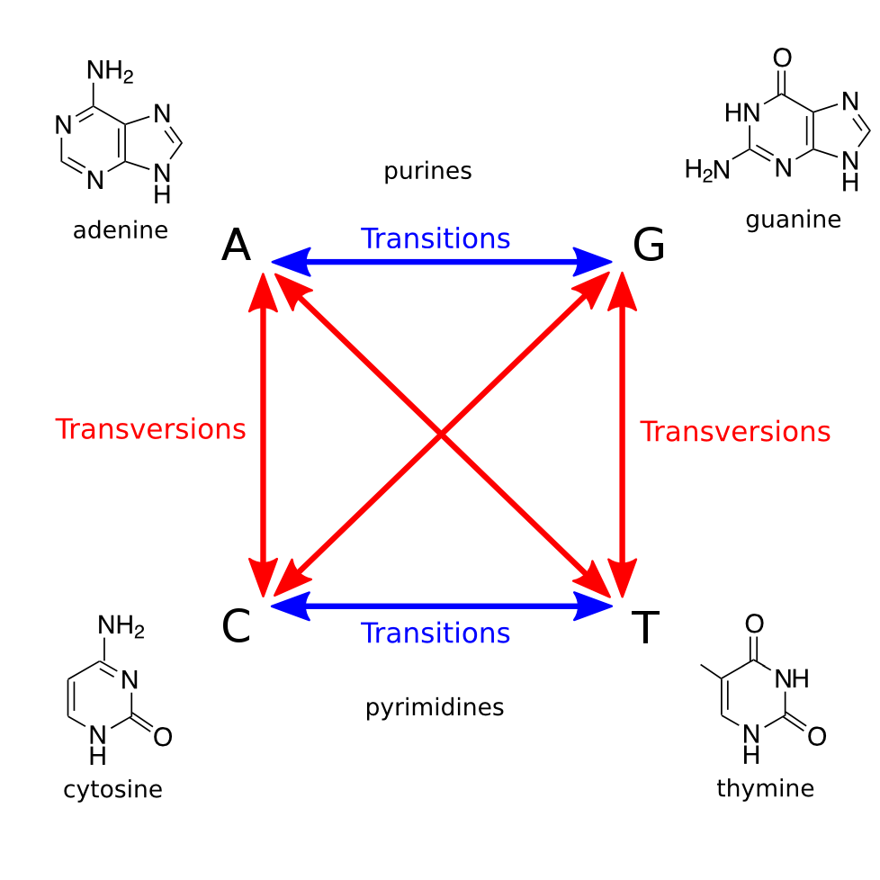
Ti/Tv ratio
Transition is more
frequent than transversion
Ti/Tv ~1.5 for whole genome
Ti/Tv ~2.0 for exome
Ti/Tv = 2/4 = 0.5 for random, uniform, sequencing error

Slide 41
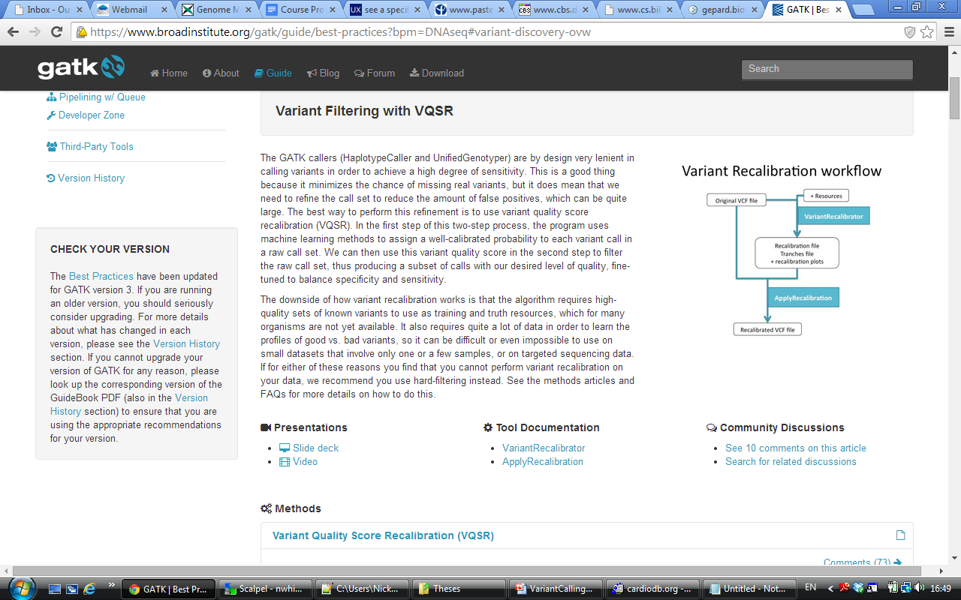
GATK soft filtering - VQSR
Variant quality score recalibration
Machine learning to assign well calibrated probabilities to each variant using a high quality set of know variants as training and truth resources – VariantRecalibrator
Filtering based on this new quality score - ApplyRecalibration
Requires large, high-quality set of variants from organism of interest
Needs a large number of samples run at one time to learn profiles of good and bad variants

Slide 42
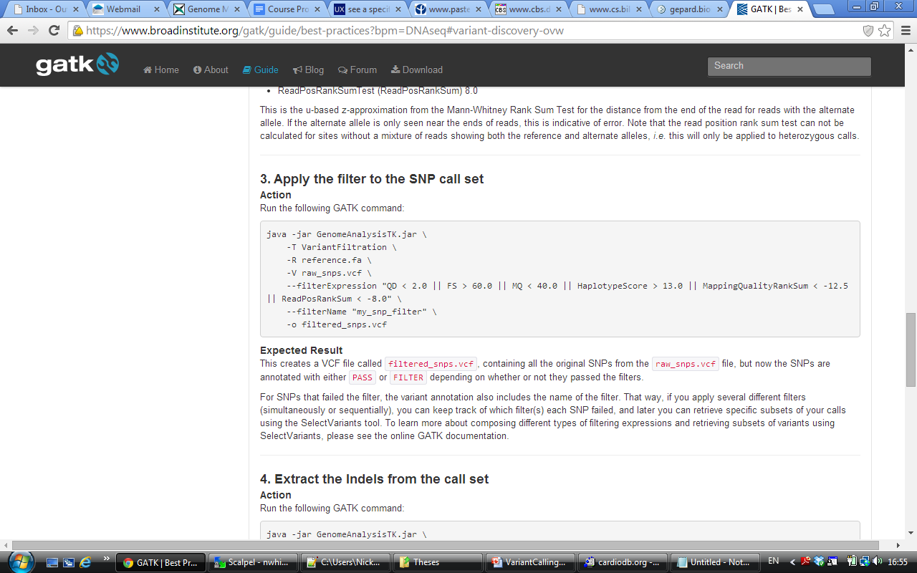
GATK hard filtering best practice
Quality/Depth
Root mean square of mapping qualities of all reads
FisherStrand – Phred scaled P-value to detect strand bias
Mapping qualities of read with alternate vs reference alleles
Tests if alternative allele only seen at ends of reads
Consistency of site with only 2 haplotypes – assumes diploid

Slide 43
Workflow
Sequencing
Read Mapping
Pre-processing
Variant Calling
This talk
Variant Filtering
Variant Annotation
Filtering/ Prioritisation
Validation

Slide 44
Functional annotation
What/where in the genome does the variant map?
Protein coding?
Synonymous or non-synonymous?
Frame-shift or frame-preserving?
Other functional regions (e.g. Splice sites, promoter/enhancer regions, ncRNAs)
Annovar/VEP
Is the position conserved?
PhastCons
GERP
PhyloP

Slide 45
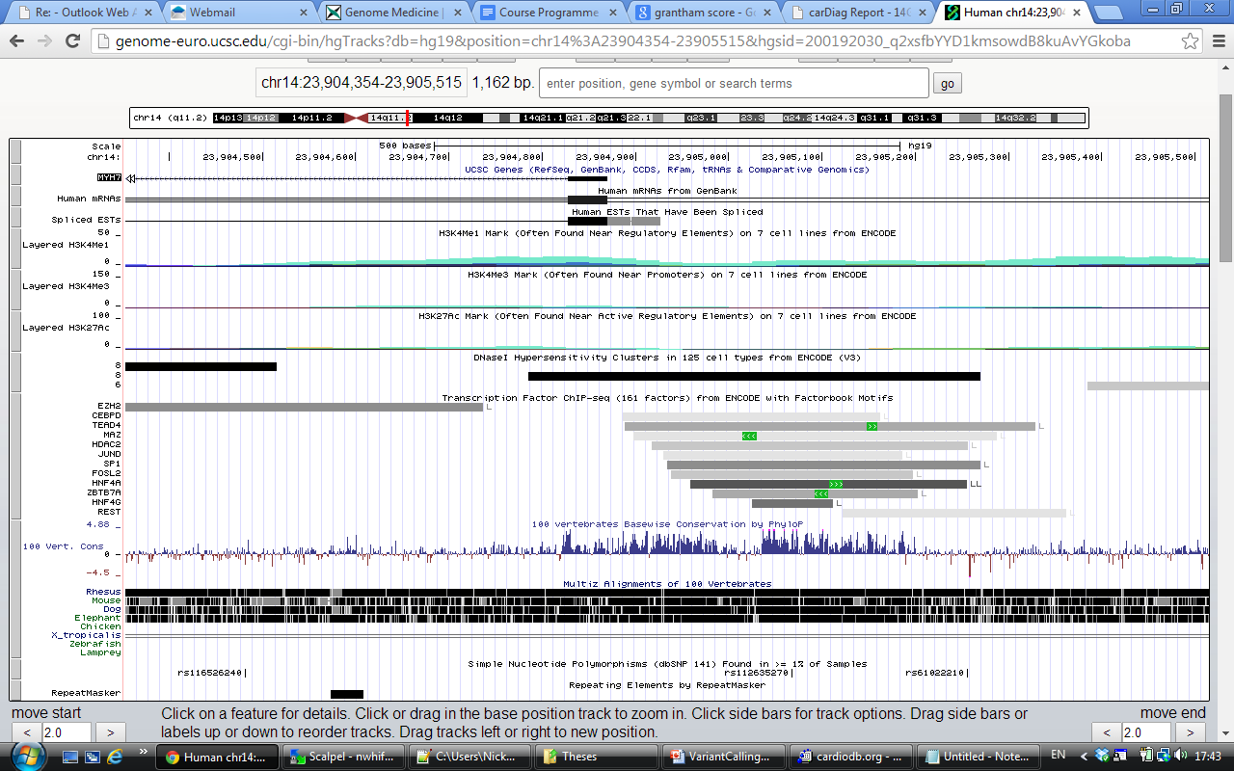
UCSC genome browser

Slide 46
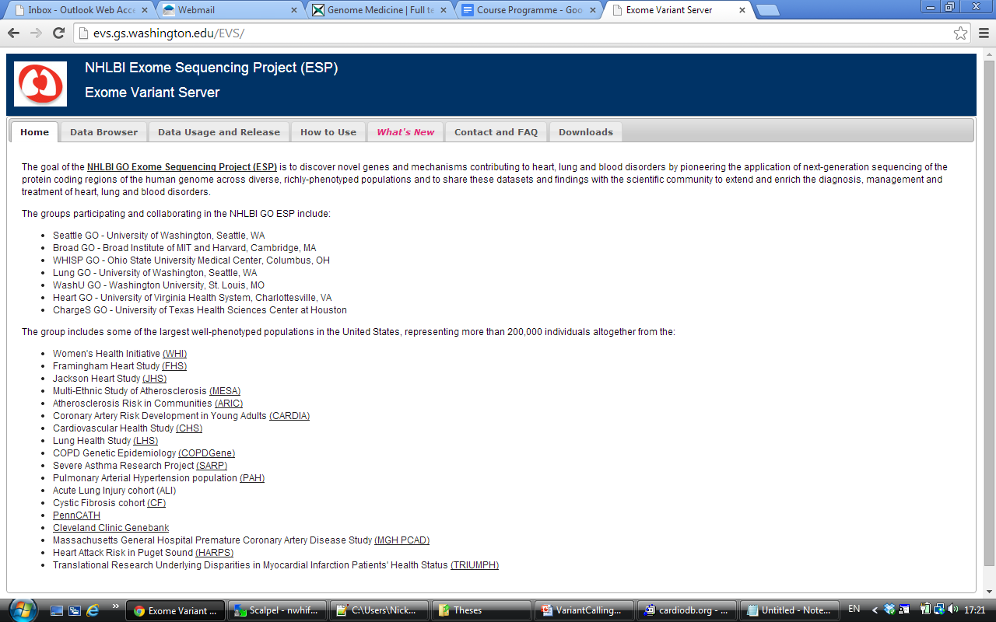
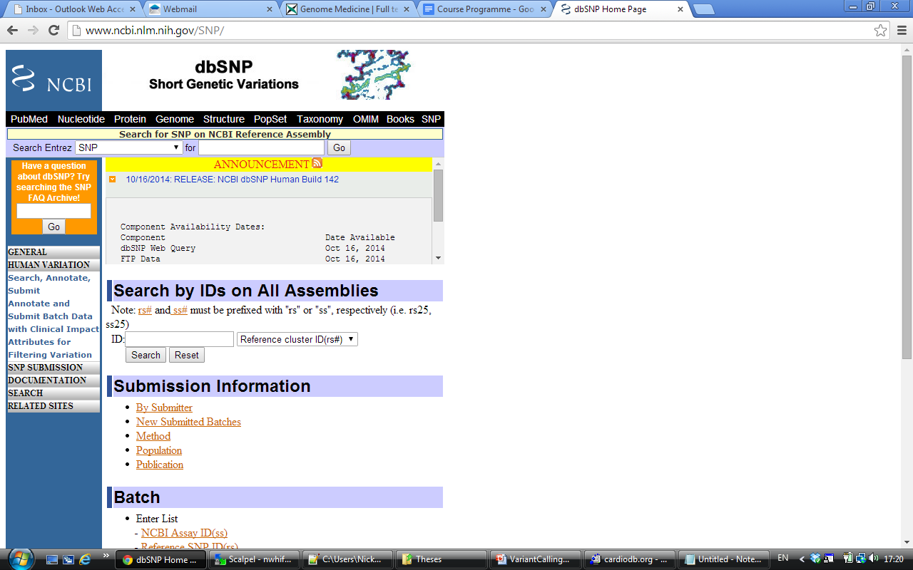
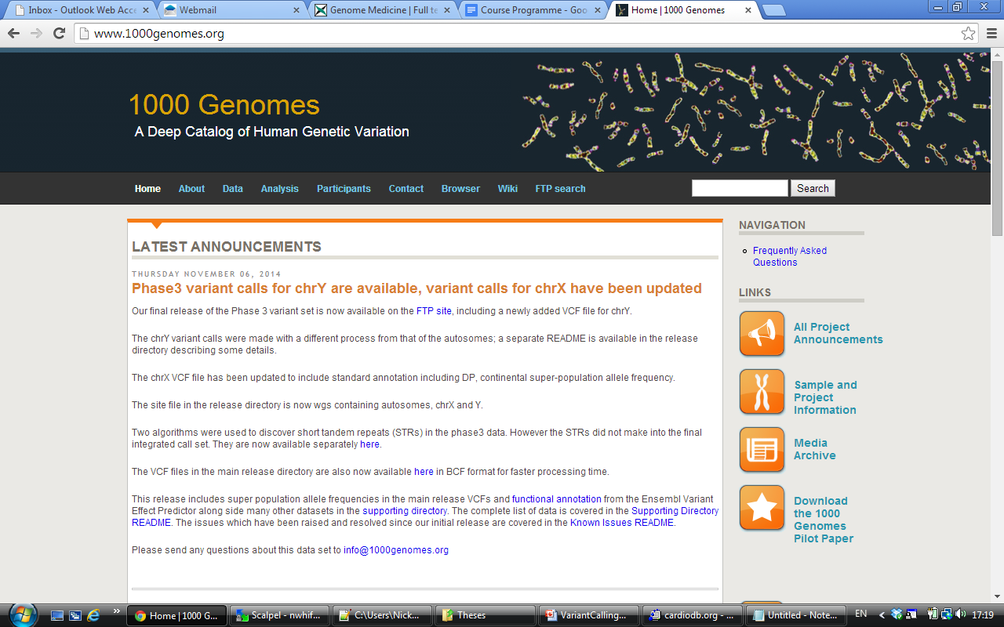
Annotation - frequency
Frequency in public variant resources
EVS (exome variant server)
dbSNP
1000 genomes
Can be inaccurate and incomplete

Slide 47
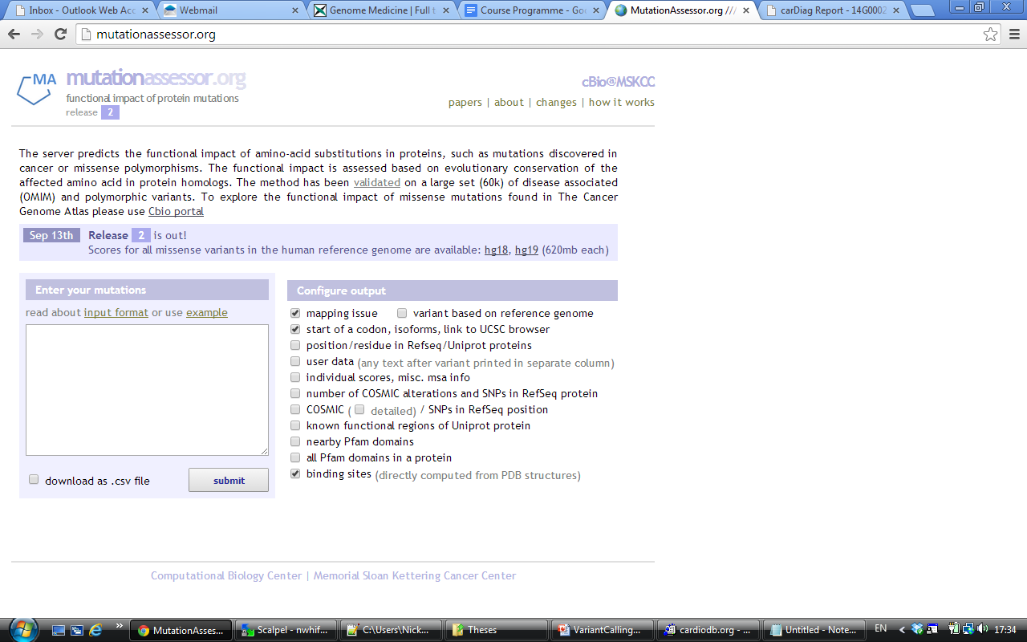
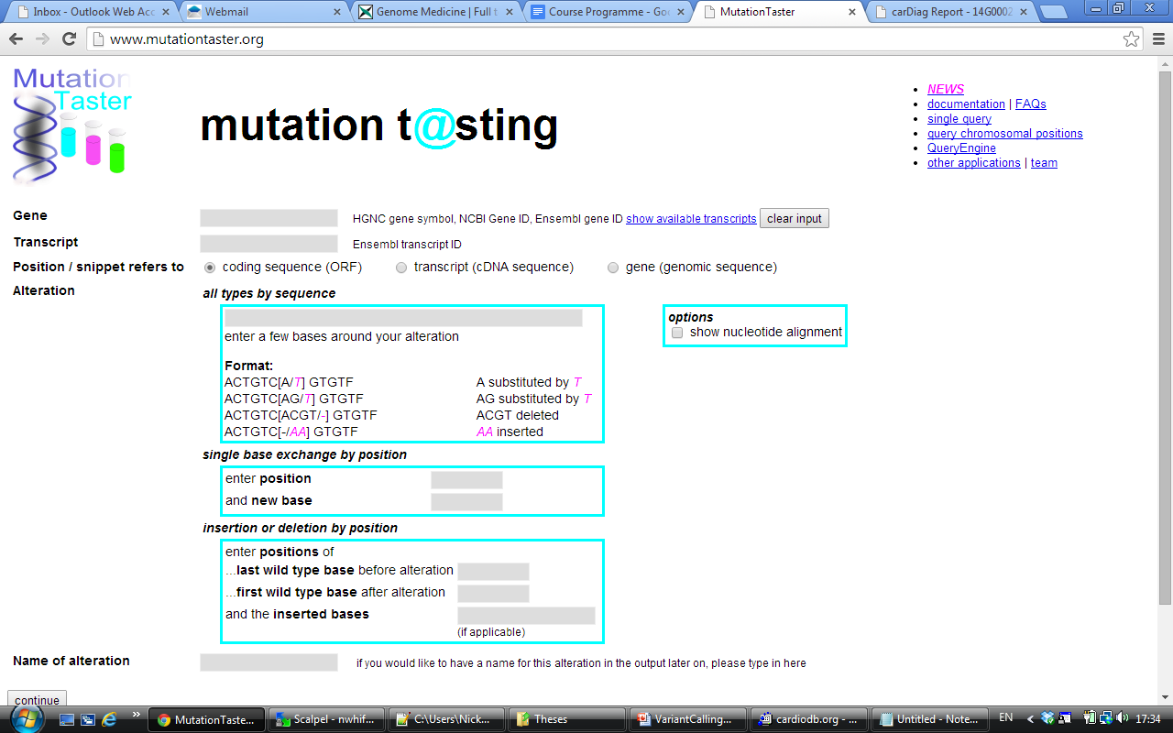
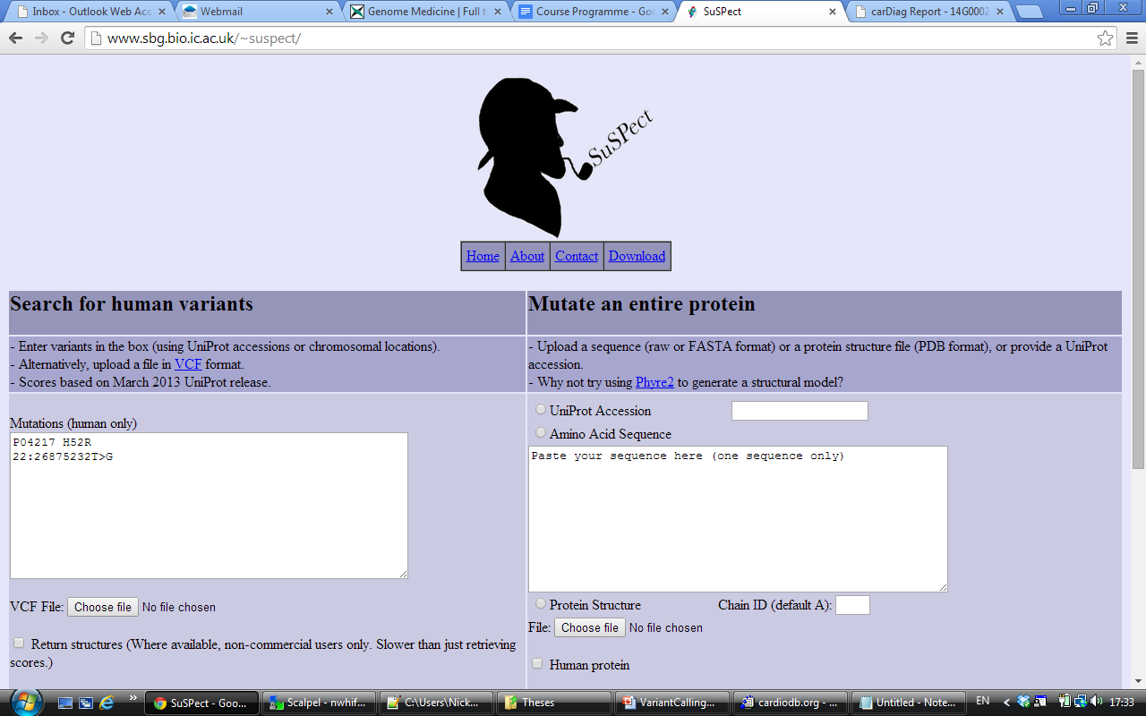
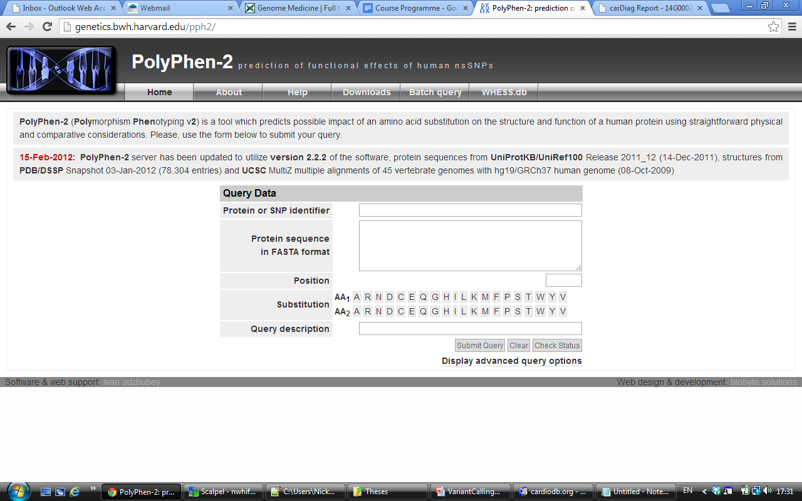
Annotation - deleteriousness
Various tools attempt to assign scores of deleteriousness to variants
SIFT
Polyphen2
CADD
CONDEL
MutationTaster
MutationAssessor
Grantham
SuSPect
Mainly only for protein coding regions
Look for a consensus between tools

Slide 48
Summary
Pre-processing of BAM files is necessary before variant calling
Variant callers estimate the probability a difference is a variant rather than a sequencing error – lots of tools
Indels are more difficult to call than SNVs
Algorithms have high sensitivity so filtering is needed to remove any remaining errors
Annotation allows us to prioritise variants that may have a role in a trait/disease

